Slide 1

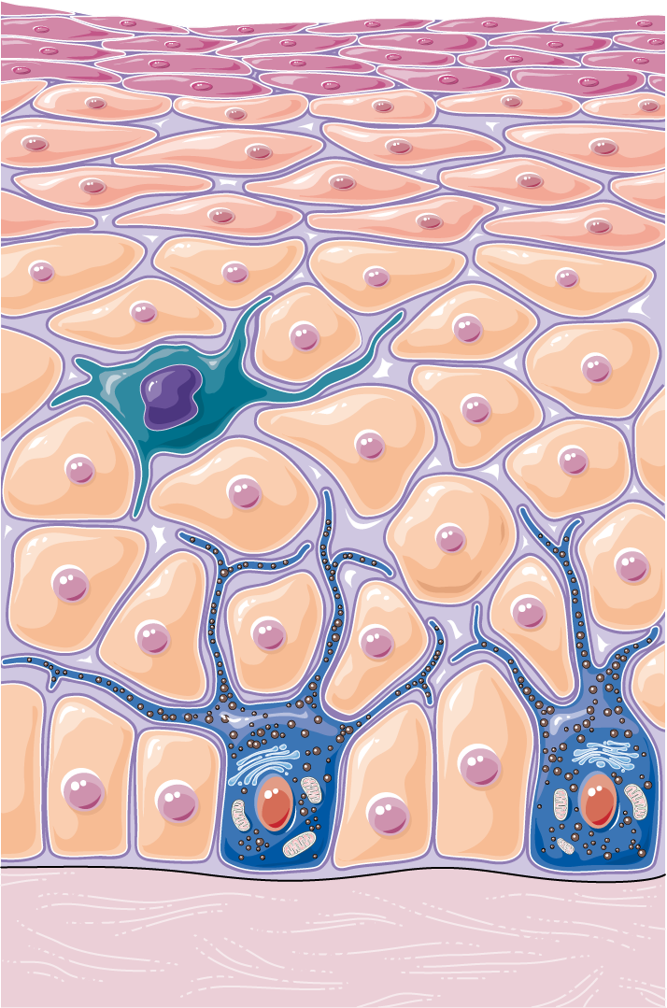
Many-to-Many-Alignment-Learning-for-Histopathology-Image-Classification-using-Vision-Language-Models
TERM PAPER PRESENTATAION
SPECIAL TOPICS IN DEEP LEARNING
ICS 590
Dr. Muzammil Behzad
PRESENTED BY
Quratulain Arshad
g202523250@kfupm.edu.sa

Slide 2
Terminologies
Pathology | Branch of medical science that is focused on the study and diagnosis of disease.
Histopathology | Diagnosis and study of diseases of the tissues, and involves examining tissues and/or cells under a microscope.
Computational Pathology | A brand-new discipline that aims to enhance patient care by utilizing advances in artificial intelligence and data generated from anatomic and clinical pathology.
Vision Language Model | Fusion of vision and natural language models. It ingests images and their respective textual descriptions as inputs and learns to associate the knowledge from the two modalities.
Whole Slide Images | Also called “virtual” microscopy, involves digitally scanning a tissue slide containing thin sections of tissue specimens for microscopic examination and storing it as digital images. This process allows for remote collaboration.
Weakly Supervised Learning | Weak supervision covers a wide range of methods where models are trained using partial, inexact, or otherwise inaccurate information that is simpler to supply than hand-labeled data
Self-Supervised Learning | A paradigm in machine learning where a model is trained on a task using the data itself to generate supervisory signals, rather than relying on externally-provided labels.
Contrastive Learning | A self-supervised learning technique where the model learns by pulling similar samples closer and pushing dissimilar samples apart in the embedding space
Zero Shot Learning | A technique where a model predicts classes it has never been trained on, using semantic descriptions (text prompts or attributes)

Slide 3
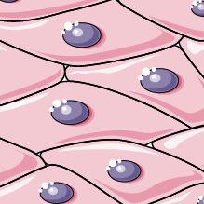
Table of contents
01
02
03
04
05
06
Challenges in Histopathology
Limitations of Learning Models
Problem
Statement
Proposed Methodology
Results
Conclusion

Slide 4
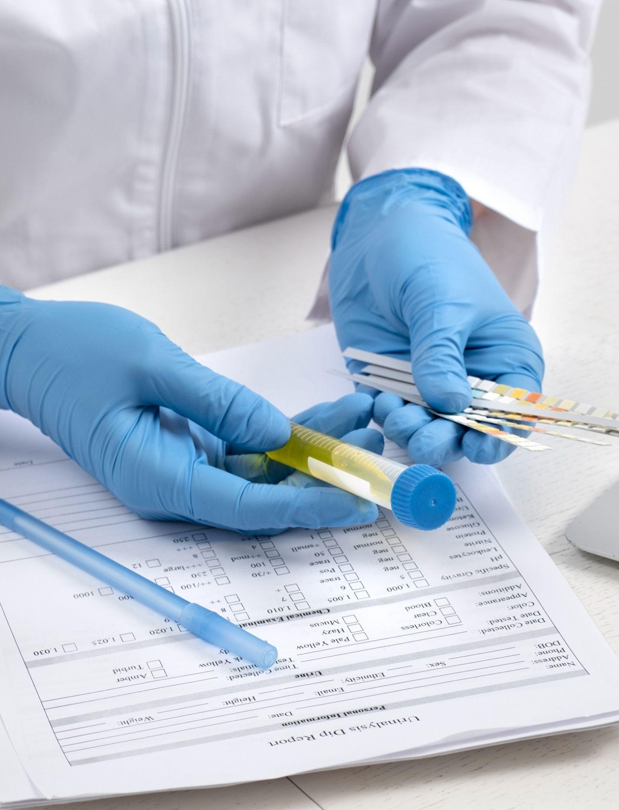
01
Challenges in Histopathology

Slide 5
Challenges in Histopathology
Histopathology-specific Challenges
Problems with
CNNs & ViTs
Deep learning models CNNs and vision transformers (ViTs) have demonstrated strong performance in tasks such as tumor detection, subtype classification, and cellular composition analysis.
But these approaches remain heavily dependent on large, expertly annotated datasets, which are costly, time-consuming to curate, and often institution-specific.
Histopathology introduces substantial domain-specific challenges:
Different hospitals use different staining protocols
Different scanners produce different resolutions and color profiles
Tissue preparation varies between labs
Datasets differ in morphology, artifacts, and disease distribution
inter-observer differences i.e. two or more clinicians/pathologists do not agree on the diagnosis, label, or annotation of the same histopathology image
Leads to domain shift, causing trained models to perform poorly when applied across different clinical centers

Slide 6
02
Limitations of Learning Models

Slide 7
Categories of Models for Histology Image Calssification & Segmentation
Weakly Supervised
Self
Supervised
Vision Language Supervised
Use data with labels at a broad level, without needing detailed annotations for every instance
Learn from the data itself without using labels, using pretext tasks to boost downstream task performance
Integrate textual descriptions with visual data to pre-train deep models.

Slide 8
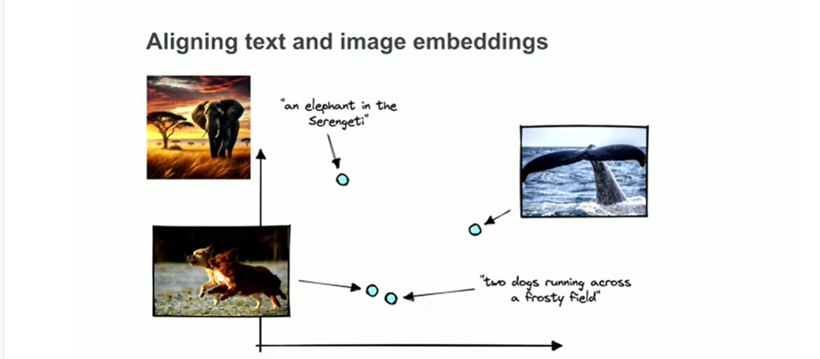
Vision Language Supervised Models
What they are
Adhering to the conventional VL model training approach, these methodologies leverage paired visual-textual data within a contrastive learning framework to ensure that representations of similar Visual-Textual concepts are drawn closer together, while divergent ones are distanced
Models that are trained using paired image and text data.
During training, each image is linked with one or more text descriptions.
The supervision signal is the similarity between the image and the corresponding text caption.
How they work
They learn to align visual features with language features.
They require supervision in the form of image–text pairs.
Examples: CLIP, PLIP, BiomedCLIP, CONCH

Slide 9
Limitations of Learning Models
Paradigm | Traditional Histopathology | Supervised deep learning in Histopathology | Weakly-supervised learning in Histopathology | Self-supervised learning in Histopathology | Vision-language models for Computational Pathology
Key Strengths | Clinical gold standard Leverages broad human expertise | High accuracy with large curated Labels Models can learn spatial/graph context | Uses slide-level labels; attention maps offer interpretability | Learns from vast unlabelled corpora Strong downstream features | Open-vocabulary recognition; versatile zero/few-shot transfer
Key Limitations | Inter-observer variability Labour-intensive Overlooks tissue heterogeneity | Requires extensive annotations Performance drops under domain shift | Still label-dependent May miss subtle local cues Bag design sensitive | Computationally demanding Heavy augmentation No inherent language grounding | Require millions of image text pairs and high computational cost Often single-prompt, Single-scale alignment

Slide 10
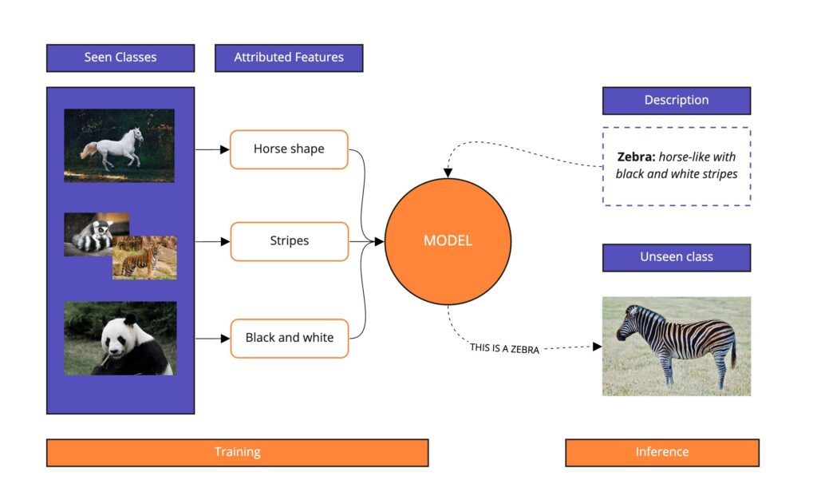
Zero Shot Learning
.
What is it
A learning setup where the model is asked to classify or recognize classes that it never saw during training.
How it Works
At inference time you provide text prompts for new, unseen classes.
The model computes similarity between the image embedding and the text embedding.
It predicts the class with the highest similarity score

Slide 11
Zero Shot Learning
.
What is it
A learning setup where the model is asked to classify or recognize classes that it never saw during training.
How it Works
At inference time you provide text prompts for new, unseen classes.
The model computes similarity between the image embedding and the text embedding.
It predicts the class with the highest similarity score

Slide 12
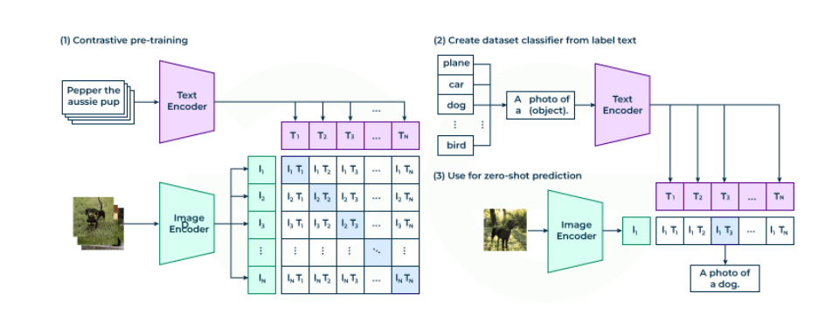
Contrastive Language Image Pretraining (CLIP)
An advanced AI multimodal model developed by OpenAI and UC Berkeley that combines knowledge of English Language concepts with semantic knowledge of images.
It has the unique ability to understand and relate both textual descriptions and images
It is first trained on many image–text pairs to compare correct vs incorrect matches, so that it learns a shared understanding of language and images.
CLIP has:
an image encoder (sees pictures)
a text encoder (reads sentences)

Slide 13
CLIP Versions
Model | Year | Backbone | Training Data | Goal / Improvement | Key Strengths
CLIP (Original) | 2021 | ResNet / ViT | 400M image–text pairs | Foundational contrastive vision–language model | Excellent zero-shot, broad generalization
OpenCLIP | 2022 | ViT (various sizes) | LAION-400M/LAION-2B | Fully open-source re-implementation | Scalable, wide model zoo, reproducible
BioCLIP | 2023 | ViT-B/16 | PMC papers + medical images | Adapts CLIP to biomedical domain | Better medical text understanding
MedCLIP | 2022 | ViT-B | MIMIC-CXR + clinical notes | Medical VL alignment for radiology | Strong on CXR zero-shot tasks
PLIP | 2023 | ViT-L | 1M histopathology image–text pairs | Pathology-specific CLIP | Best zero-shot WSI patch classification
BiomedCLIP | 2023 | ViT-L/14 | 15M biomedical captions | Large-scale biomedical VL pretraining | Strong in cross-modality medical tasks
CONCH | 2024 | ViT-B | Multi-magnification histopathology | Multi-scale VL alignment | Much better for multi-resolution pathology tasks
CPLIP | 2024 | ViT-L | 5M histopathology prompt bags | Many-to-many image–text alignment | State-of-the-art WSI zero-shot classification
CPLIP: Zero-Shot Learning for Histopathology with Comprehensive Vision-Language Alignment
Computer Vision and Pattern Recognition Conference (CVPR) 2024

Slide 14
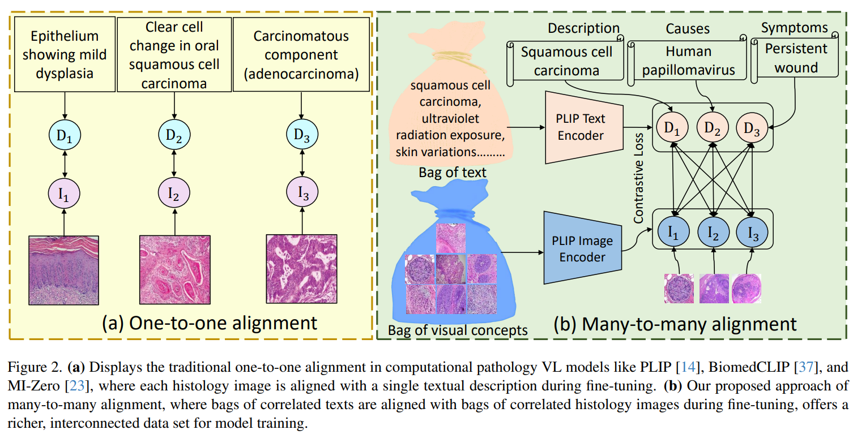
Comprehensive Pathology Language Image Pre-training (CPLIP)
Designed specifically for histopathology images, like whole slide images and patches from tissue biopsies
Uses a pathology specific dictionary, generates pathology style text descriptions with language models, then aligns those descriptions with pathology images.
Uses a many to many contrastive loss instead of simple one image one caption
Better zero shot classification and segmentation in histopathology, more interpretable for pathologists

Slide 15
03
Problem Statement

Slide 16
Problem Statement
Despite the rapid progress of vision-language models in computational pathology, significant challenges remain before zero-shot histopathology becomes a reliable clinical tool. One major limitation concerns modality alignment, as most current methods rely on one-to-one alignment between an image patch and a single text prompt. This does not adequately reflect the inherently multi-scale and multi-semantic nature of pathology images, which can encode morphology, disease etiology, grading indicators, and contextual tissue organization.
A second challenge is dataset heterogeneity and domain shift. Whole slide images vary widely due to differences in staining protocols, scanners, magnification, and institution-specific workflows. As a result, vision-language models trained on one dataset frequently underperform on external data, especially for unseen disease categories or rare cancer presentations

Slide 17
03
Proposed Methodology

Slide 18
Proposed Methodology
Contributions
Propose a novel architecture that integrates a pathology-specific vision–language encoder (PLIP) with a general-purpose CLIP model to capture both domain-dependent and generic visual–textual semantics for histopathology image classification.
Introduce a new alignment strategy that establishes interactions between multiple visual and textual embeddings, enabling richer semantic correspondence between histological patterns and diagnostic textual concepts. This alignment forms a multi-level similarity matrix that enhances discriminative learning under zero-shot conditions.
Design clinically relevant textual prompts that reflect benign and malignant morphological cues, bridging the linguistic gap between medical reporting terminology and visual pathology features.
Extensive experiments on the BreakHis dataset demonstrate the effectiveness of the proposed approach in classifying breast histopathology images without task-specific fine-tuning, highlighting its scalability and annotation efficiency for digital pathology applications.

Slide 19
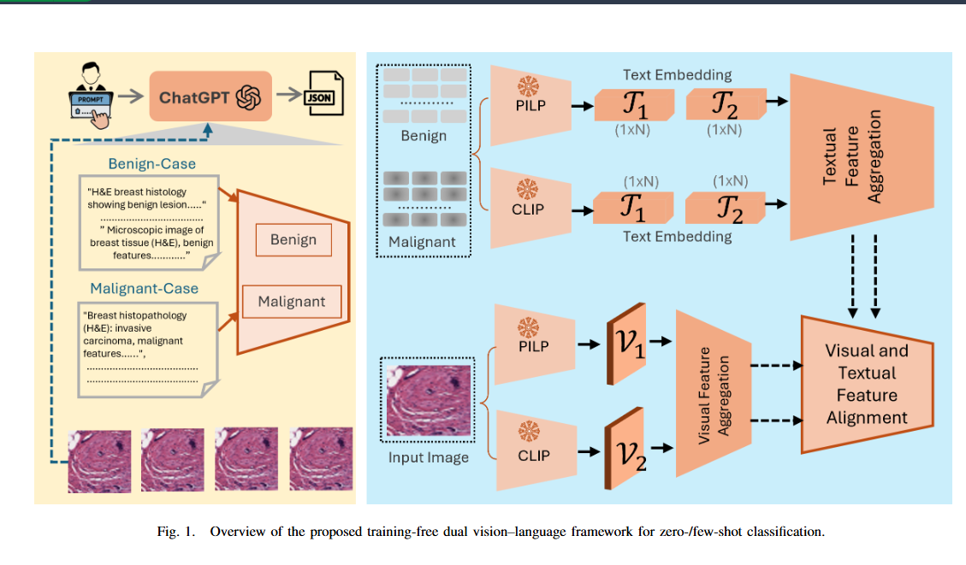
Proposed Methodology

Slide 20
Results
Experimnetal Setup
Dataset Description.
All experiments are conducted on the BreakHis dataset, a publicly available benchmark for breast histopathology image classification.
BreakHis contains 7,909 microscopic images of benign and malignant breast tumors collected from 82 patients, acquired under four optical magnifications (40×, 100×, 200×, and 400×).
Each image is an H&E-stained RGB patch of size 700×460 pixels.
For this study, we curate a custom 10-folder subset comprising an equal number of benign and malignant cases (five folder search) to create a balanced binary evaluation set. This subset preserves magnification diversity and reflects real diagnostic variance in tissue morphology.

Slide 21
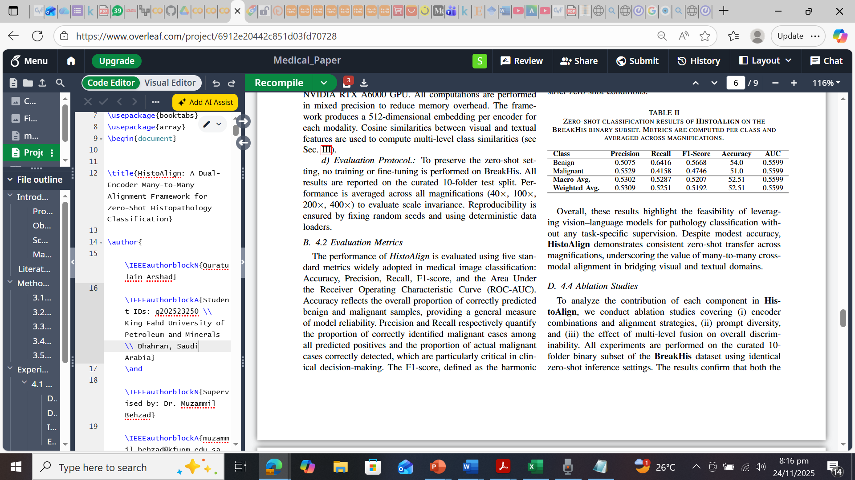
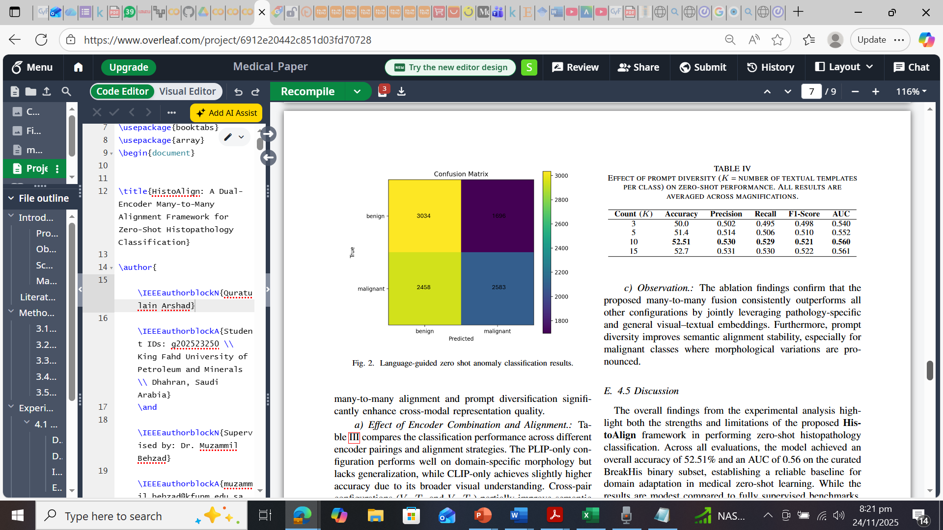
Results

Slide 22
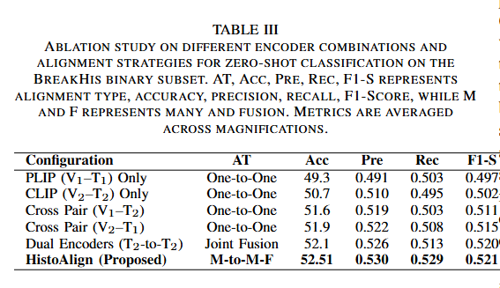
Results

Slide 23
Conclusion
In this work, HistoAlign, is presented which is a dual-encoder zero-shot learning framework designed for breast histopathologyvimage classification.
By leveraging a many-to-many cross-modal alignment between pathology-specific and generalvvision–language encoders, the proposed model effectively bridges visual and textual representations without requiringany supervised fine-tuning.
Comprehensive experiments on the BreakHis dataset, including a curated 10-folder binary subset, demonstrated that HistoAlign can transfer semantic knowledge from large-scale natural image–text pairs to highly domain-specific medical imagery.

Slide 24
Limitations
Despite its promise, several limitations persist.
The reliance on handcrafted clinical prompts may constrain linguistic coverage and hinder generalization to unseen tissue morphologies.
Furthermore, the visual encoders, pretrained primarily on natural images, are suboptimal for microscopic texture representation, leading to occasional misclassification of low-grade malignancies

Slide 25
Future Directions
Future work will focus on addressing these challenges through adaptive prompt optimization, stain-invariant visual pretraining, and the integration of few-shot or weakly supervised fine-tuning mechanisms to reduce domain bias.
Extending the framework to multi-class classification and cross-dataset generalization tasks will also be explored to enhance the clinical applicability of vision–language models in digital pathology.

Slide 26
Results and conclusions
Background
Briefly introduce the context of the investigation, such as the medical condition or problem being addressed and the goals
Study design
Describe the design of the study, such as whether it was a randomized controlled trial or observational study, the sample size and the inclusion and exclusion criteria
Findings
Summarize the main findings of the investigation, including statistical results and any important trends or patterns observed
Impact
Discuss the implications of the findings for patients, healthcare providers and other stakeholders. You could also mention any potential limitations of the study or areas for future research
Conclusions
1
Briefly summarize the main findings of the study or analysis
2
Discuss the implications of the findings and how they relate to the original research question
References
Include a reference page with the sources used in your presentation. List the sources in alphabetical order and include the author's name, the title of the source, the publication date and the publisher or URL

Slide 27
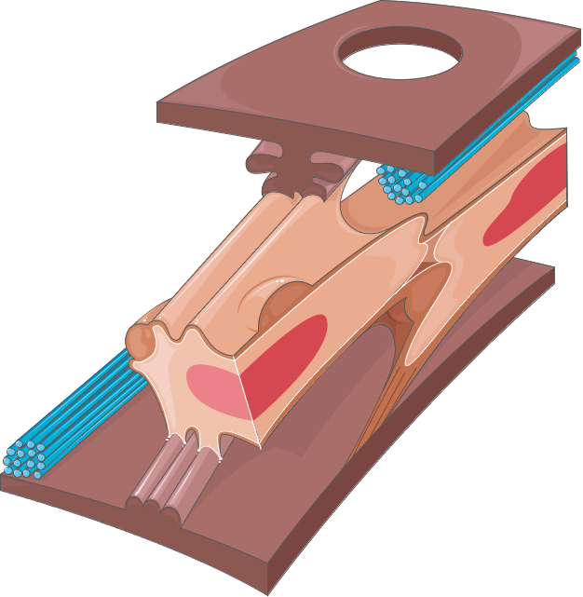
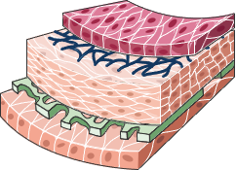
Thanks!

